Slide 1


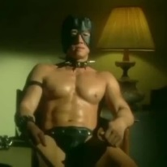
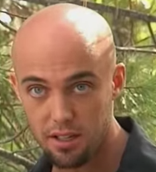


Give or spread the cancer all the way home.
Cart
Check out
Forsen gachimuchi fan-merch.
Username:
Password:
Login
Menu (Home, Men, Women, Accessories, Phone cases, about, contact)
A(I)DS
Check out our supporters!
Welcome to a fan-made cancer site that supports our dad, Forsen (a.k.a Sebastian Fors).
For more information, please visit http://www.twitch.tv/forsen
Enter the never-lucky give-away!:
***Link***

